Slide 1
CI/CD: GITHUB ACTIONS
ERIC VON LAGUNA, Stoyan Grozdev

Slide 2
AGENDA merge the points later
Introduction to this workshop
Git Workflow Refresher
Introduction to GitHub Actions
Main Features of GitHub Actions
Workflow Syntax and Structure
Practical Examples
Runners
Testing and Job Success
Branch-Specific Workflows
GitHub Actions Marketplace
Advanced Topics
Comparison to Other CI/CD Tools
Practical Assignment
Q&A and Wrap-Up

Slide 3
Think of the process of your development cycle!
How do you ensure that all developers run the tests?
How do you ensure code quality and consistency across your team?
Are there repetitive tasks in your github workflow that could be automated?
How do you ensure that configuration information is secured?

Slide 4

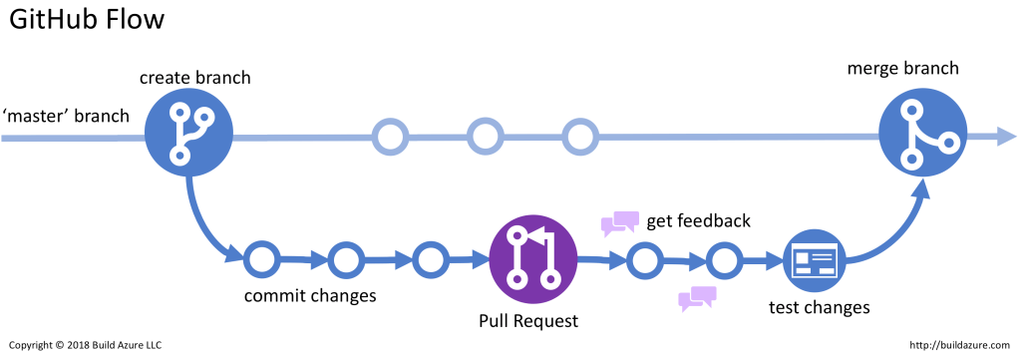
Github workflow refresher
Branch types: development, staging, production
Base commands: push, pull, merge
Example: https://build5nines.com/introduction-to-git-version-control-workflow/

Slide 5
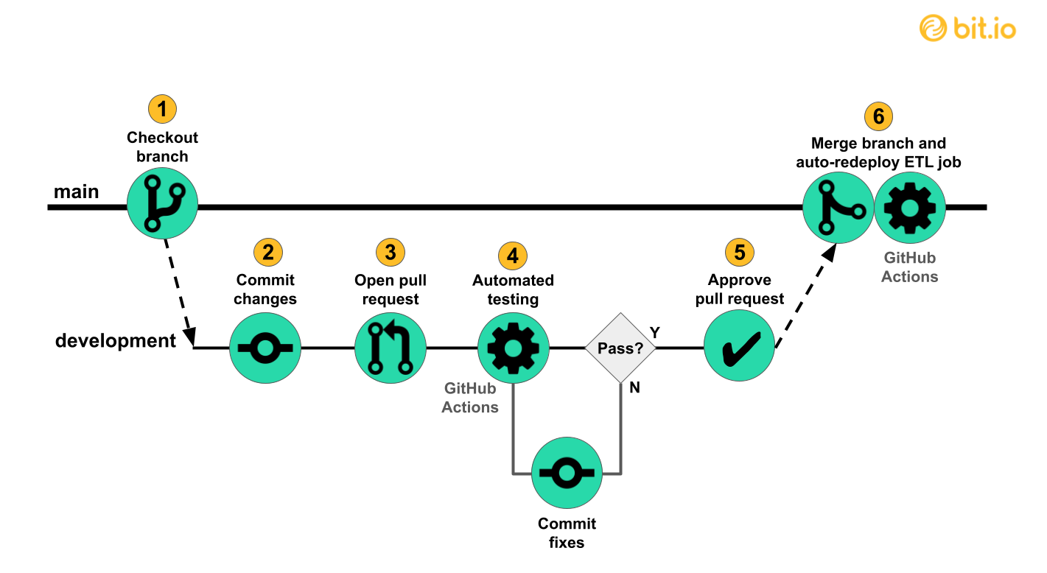
Github Actions introduction
Example: https://innerjoin.bit.io/making-a-simple-data-pipeline-part-4-ci-cd-with-github-actions-733251f211a6
What is Github Actions?
Where does GitHub Actions fit in the picture?
Why use Github Actions?
Enhancing Git Operations
Workflow automation

Slide 6
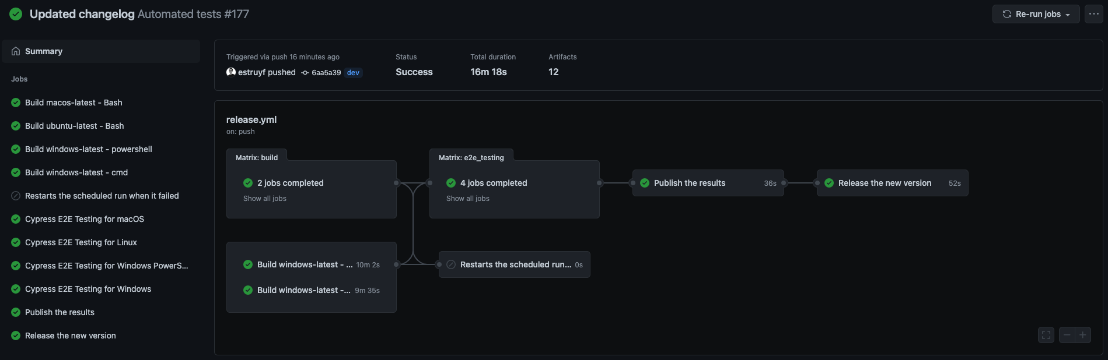
Example demo

